Slide 1


5 Major Treaties & Alliances in the Build Up to World War One
1. What were the two main alliances before World War I?
A) Triple Entente (France, Britain, Russia) and Dual Alliance (Germany, Austria-Hungary)
B) Triple Alliance (France, Britain, Russia) and Dual Entente (Germany, Austria-Hungary)
C) NATO and Warsaw Pact
D) United Nations and League of Nations
2. What did the Treaty of London (1839) guarantee?
A) Germany would invade Belgium
B) Belgium’s neutrality and independence
C) France would attack Germany
D) Austria-Hungary could control Serbia
3. Who signed the Dual Alliance in 1879?
A) Britain and France
B) Italy and Belgium
C) Russia and France
D) Germany and Austria-Hungary
4. Which country joined the Triple Alliance in 1882?
A) Russia
B) Italy
C) Britain
D) Belgium
5. Why did Germany sign the Reinsurance Treaty with Russia in 1887?
A) To prevent Russia forming an alliance with France
B) To attack Britain
C) To invade Belgium
D) To declare war on Austria-Hungary
6. What did the Franco-Russian Alliance of 1894 promise?
A) Russia would attack Britain
B) France would give land to Germany
C) If the Triple Alliance attacked one, the other would help
D) Italy would join Britain in war
7. What was the Entente Cordiale of 1904?
A) A trade deal between Russia and Japan
B) An alliance between Germany and Austria-Hungary
C) A treaty between Britain and France to settle disagreements, especially in Africa
D) A plan to attack Belgium
8. What was the Triple Entente of 1907?
A) An agreement between Britain, France, and Russia against the Triple Alliance
B) A secret treaty with Germany
C) A trade deal in Europe
D) A military plan between Austria-Hungary and Italy
9. Why did Britain declare war on Germany in August 1914?
A) Germany attacked France only
B) Britain wanted to help Austria-Hungary
C) Germany signed a treaty with Russia
D) Germany crossed Belgian border, breaking the Treaty of London
10. Why was the Triple Entente not truly a “triple” agreement?
A) It was mainly a treaty between Britain and Russia
B) It included Germany
C) France refused to join
D) Italy was part of it

Slide 2
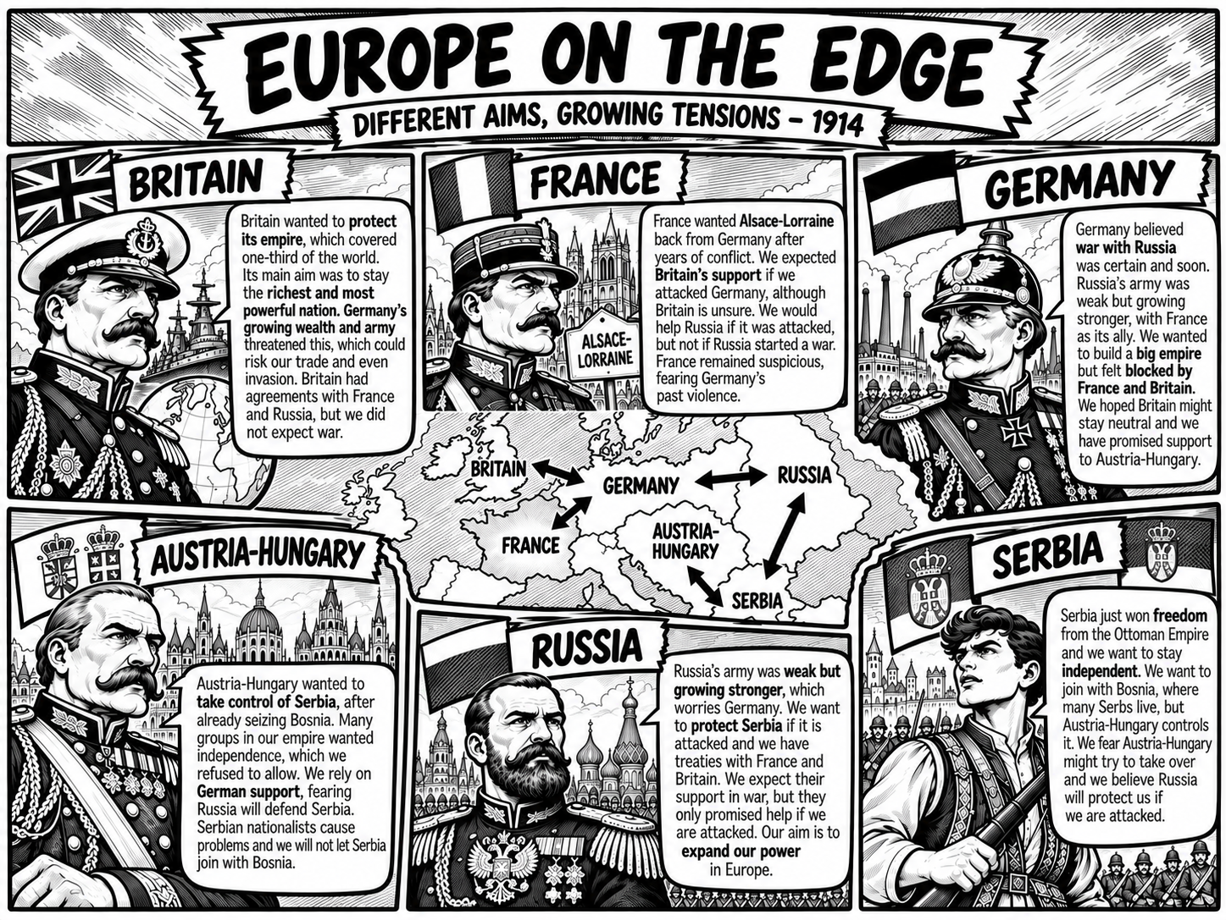

Slide 3
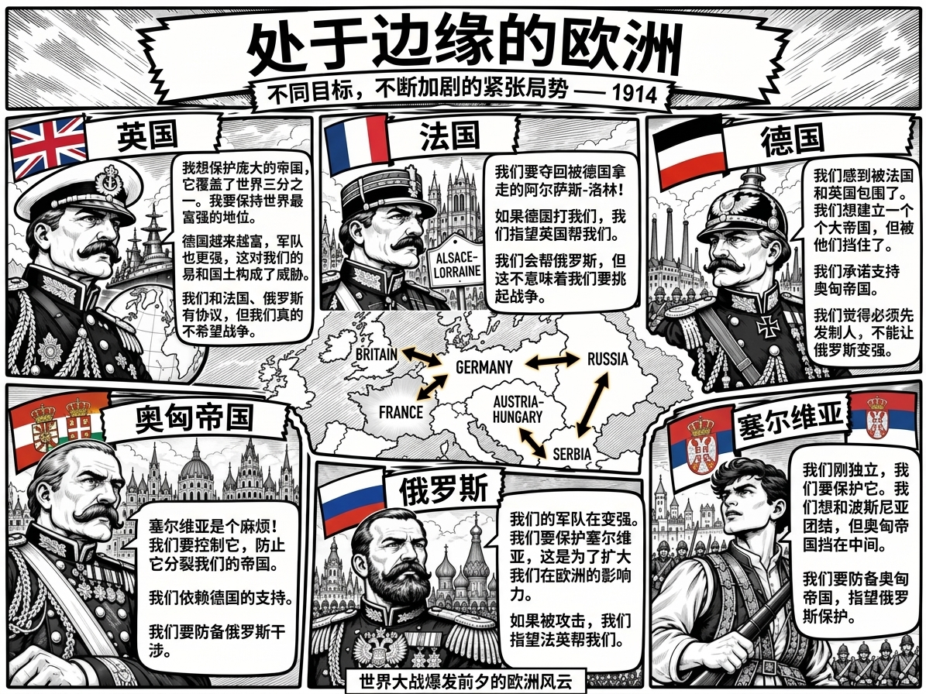

Slide 4
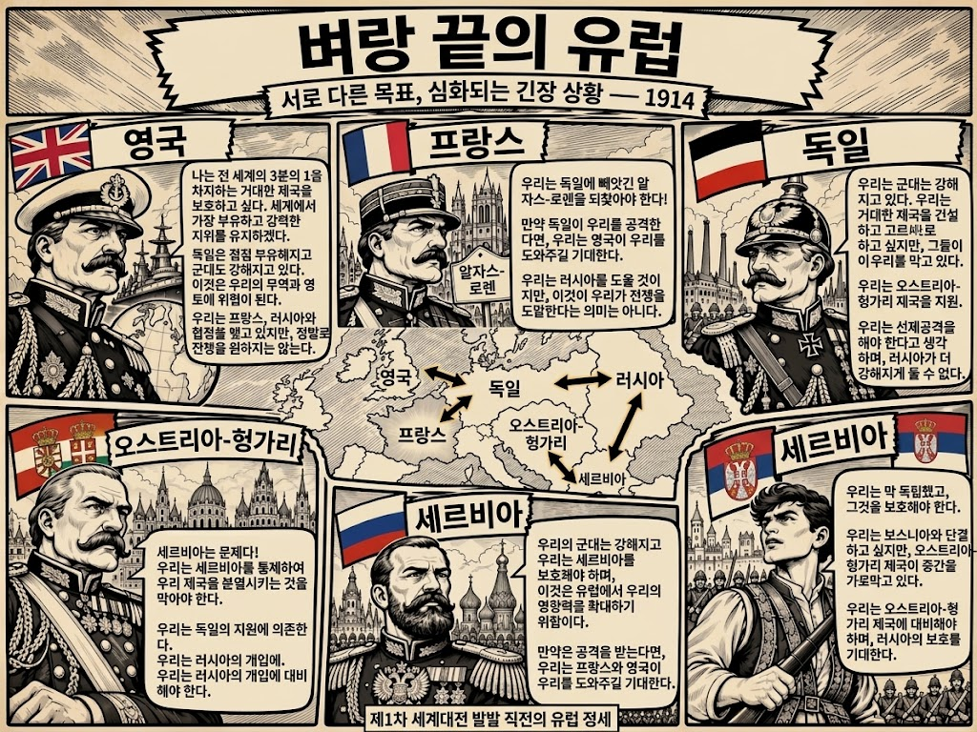

Slide 5
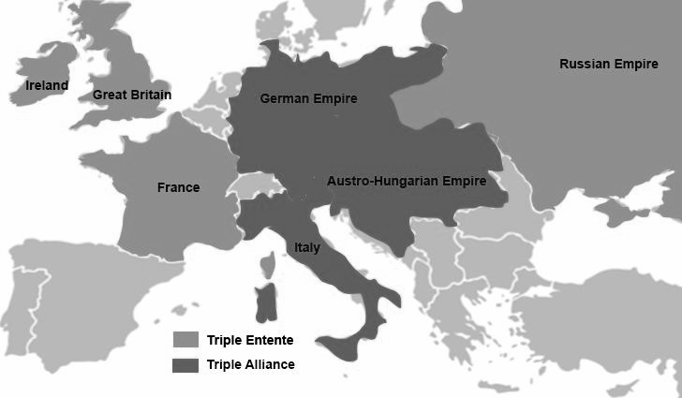
European Aims in 1913
Complete the table
Britain What is the thing they want the most? __________________________________________________________ Who stands in the way of this? __________________________________________________________ | France What is the thing they want the most? __________________________________________________________ Who stands in the way of this? __________________________________________________________ | Austro-Hungary What is the thing they want the most? __________________________________________________________ Who stands in the way of this? __________________________________________________________
Russia What is the thing they want the most? __________________________________________________________ Who stands in the way of this? __________________________________________________________ | Serbia What is the thing they want the most? __________________________________________________________ Who stands in the way of this? __________________________________________________________ | Germany What is the thing they want the most? __________________________________________________________ Who stands in the way of this? __________________________________________________________
Draw arrows to show the links between countries ‘Friend or Foe’
Britain | France | Austro-Hungary
Russia | Germany | Serbia
Friend
Foe

Slide 6
